Slide 1
Generating Art with GAN’s
Creating stable GAN’s
Emil Moghaddam

Slide 2
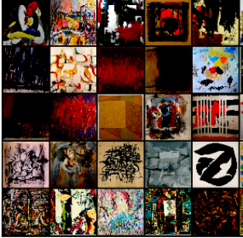
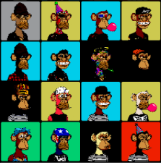
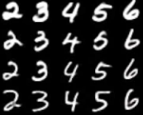
Datasets
64x64

Slide 3
Why training GAN’s are hard
Non-convergence: the model parameters oscillate and never converge
Mode collapse: the generator collapses which produces limited varieties of samples
Inherently unstable gradients:
Simultaneous
Dependency
Equilibrium between two forces
Changes the landscape
No good objective metrics

Slide 4
My approach
Create a GAN
Do a lot of hyper parameter tuning
Gave up
Read:
— Unsupervised Representation Learning with Deep Convolutional Generative Adversarial Networks, 2015
Watch:
Ian Goodfellow, Introduction to GANs, NIPS 2016.
Soumith Chintala, How to train a GAN, NIPS 2016 Workshop on Adversarial Training.
Realized all my mistakes

Slide 5
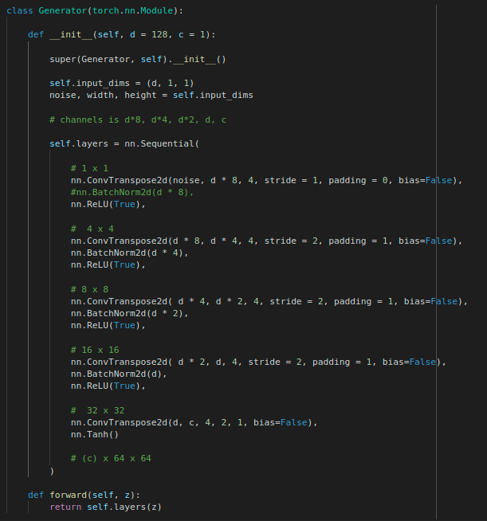
Architecture
Pooling replaced by:
Convolution
Fractionally strided convolution
Batch normalization
Relu, Leaky Relu
No fully connected layers

Slide 6
Architecture
Remove bias - mode collapse
Deconvolution parameters - checkerboard artifacts
Deconvolution and Checkerboard Artifacts, 2016.
Sigmoid and Tanh
Binary cross entropy loss

Slide 7
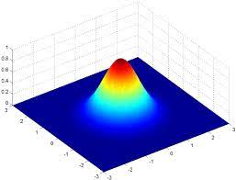
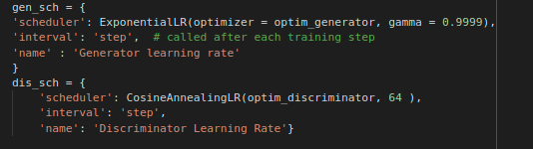
Implemented advice
Learning rate scheduling
Stable landscape
Decrease adjustments
Impossible to get the hyperparameters right
Rapid increase and decrease of learning rate
Generator noise:
Gaussian random numbers
Uniform distribution
Inverse Gaussian distribution

Slide 8
Implemented advice
One-sided label smoothing
Adding some noise to the labels
Usually as a regularization technique, and used to deal with overconfidence
“ The idea of one-sided label smoothing is to replace the target for the real examples with a value slightly less than one, such as .9 […] This prevents extreme extrapolation behavior in the discriminator …”
Decreasing noise added to input of discriminator
+= self.noize[self.current_epoch] * torch.rand(x.shape).type_as(x)

Slide 9
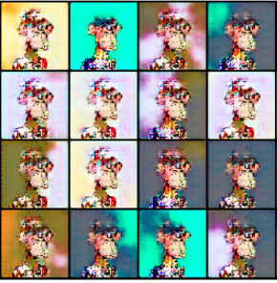
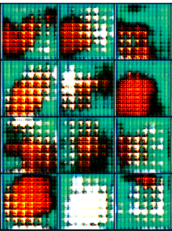
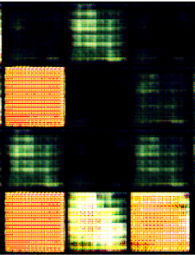
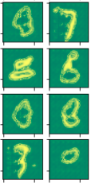
Results
logger movie

Slide 10

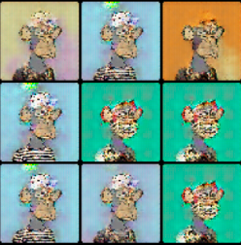


Monkeys

